Slide 1
Agentic AI
AI That Can Think, Plan and Act
Name: U. Anand Williams | Roll No: 261FB04045
Department: CSE | College: Vignan University

Slide 2
What is AI?
Artificial Intelligence means machines that can learn and make decisions.
The Evolution
We already use AI every day:
Traditional AI
Rule-based responses
1
Netflix recommendations
Google Search
Voice assistants (Siri, Alexa)
Generative AI
Creates content from prompts
2
Traditional AI mainly responds to specific inputs and gives an answer. Now, AI has moved toward systems that can perform multiple tasks on their own.
Aąentic AI
Plans and takes action
3

Slide 3



What is Agentic AI?
Agentic AI is an AI system that can work toward a goal by itself. It doesn't just answer questions — it plans and takes action.
Works toward a goal
Breaks problems into steps
Plan
Goal
Makes decisions along the way
Act
Uses tools and resources
Check
Checks results and improves

Slide 4
How Does Agentic AI Work?
A simple step-by-step process:
Provide Goal
User states desired outcome
Plan
Define steps and resources
Evaluate
Check results against goal
Interpret
AI analyzes intent and context
Act
Use tools and execute tasks

Slide 5
Generative AI vs Agentic AI
What's the difference?
 | Generative AI | Agentic AI
Main Job | Mainly generates content | Works toward a goal
How it Works | Usually responds to prompts | Can perform multiple steps
Output | Produces an answer | Can take real actions
Example | Writing an email | Managing a complete workflow

Slide 6
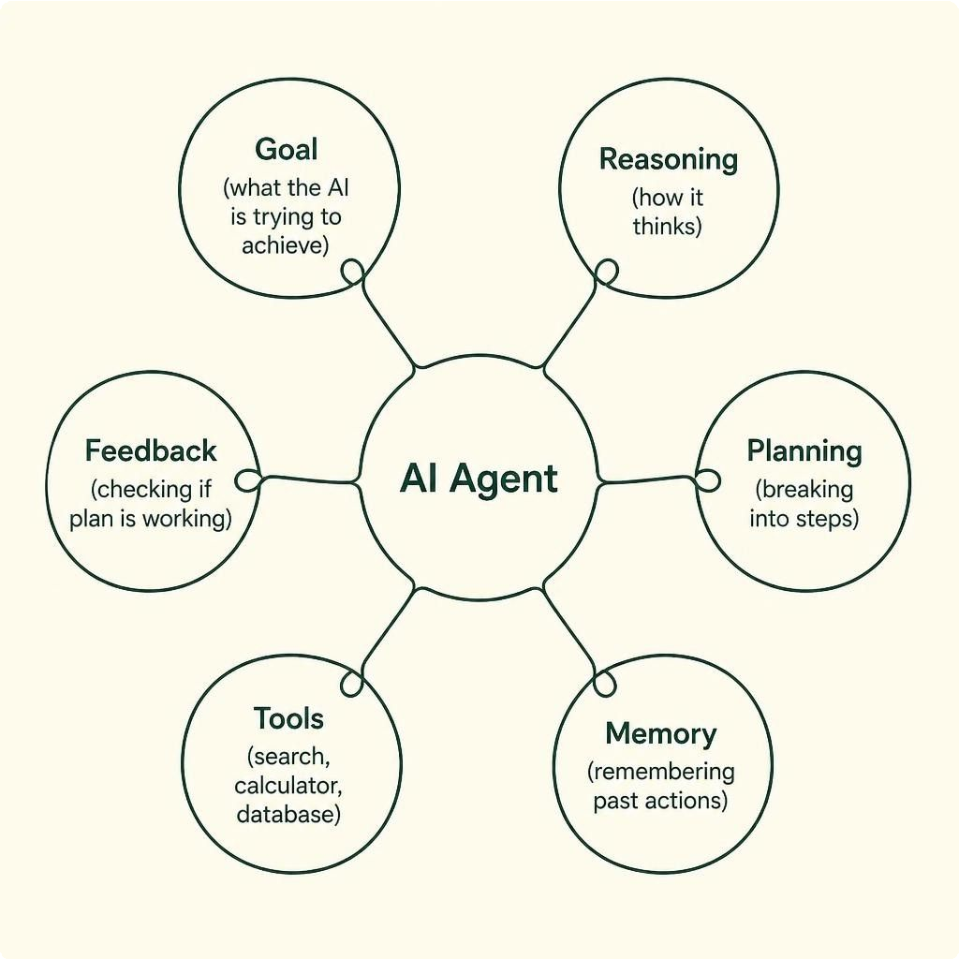
AI Agents
An AI agent needs these components to work:
Goal
What the AI is trying to achieve
Reasoniną
How the AI thinks about the problem
Planning
Breaking the goal into steps
Memory
Remembering what happened before
Tools
Search, calculator, database
Feedback
Information on whether the plan is working

Slide 7





Where Can We Use Agentic AI?
Software Development
AI writes code and fixes bugs automatically
Customer Support
AI handles customer problems without human help
Research
AI searches and summarizes findings
Personal Assistants
Schedules meetings, sends emails, manages tasks
Business Automation
Handles repetitive office work
Education
Tutors students and creates personalized learning plans

Slide 8

Example: Planning a Trip
Here's how an AI agent could handle a real task from start to finish:
1.
Destination & Budget
2. Search Flights
3. Compare Prices
4. Find Hotels
5. Day-by-Day Plan
The AI works through every step on its own — but it checks with the user before taking important actions.

Slide 9
Advantages of Agentic AI
Saves time
Automates multi-step tasks that would take humans much longer
⏱ Faster Task Completion
🔁 No Repetitive Fatigue
✅ Checks Its Own Results
🛠 Uses Multiple Tools
Works continuously
Can run 24/7 without getting tired or needing breaks
Handles complexity
Uses different tools and resources to solve hard problems
Reduces manual effort
Takes over repetitive work so people can focus on other things

Slide 10
Problems and Risks
Agentic AI is not perfect. We need to be careful:
Wrong Decisions
AI might misunderstand the goal and do the wrong thing
Privacy Issues
AI might access or misuse sensitive data
"Agentic AI is not about generating answers. It is about understanding a goal, planning the steps, and taking action."
Thank You
Security Problems
AI systems could be hacked or manipulated
Costly Mistakes
Errors without human approval can be expensive
Human Supervision
Still very important — AI should not act fully alone
High Costs
Running complex AI systems requires significant resources
Lack of Transparency
We don't always understand why AI makes certain decisions

